Slide 1


DISTRIBUTED COMPUTING
Sunita Mahajan, Principal, Institute of Computer Science, MET League of Colleges, Mumbai
Seema Shah, Principal, Vidyalankar Institute of Technology, Mumbai University

Slide 2
Chapter - 2
Network Communication

Slide 3
Topics
LAN and WAN technologies
Protocols for Network Systems
Asynchronous Transfer Mode
Protocols for Distributed Systems
  VMTP
  FLIP

Slide 4
LAN and WAN Technologies

Slide 5
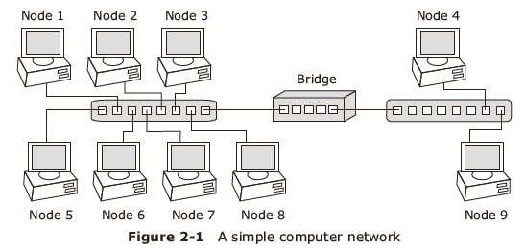
LAN and WAN Technologies
Introduction to LAN and WAN

Slide 6
Classification of Networks
Based on number of interconnected nodes and type of communication link used
  LAN,
  MAN,
  WAN,
  WLAN
  Internetwork

Slide 7
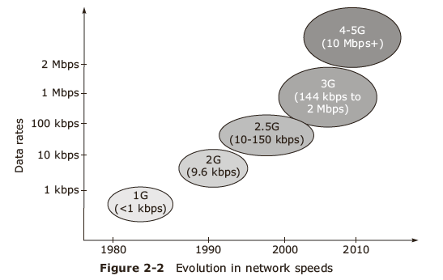
Evolution of network transmission speeds

Slide 8
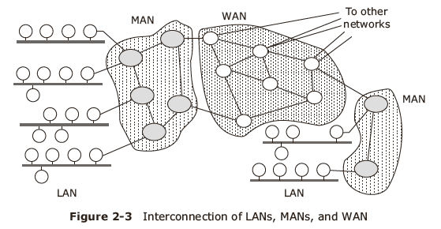
MAN

Slide 9
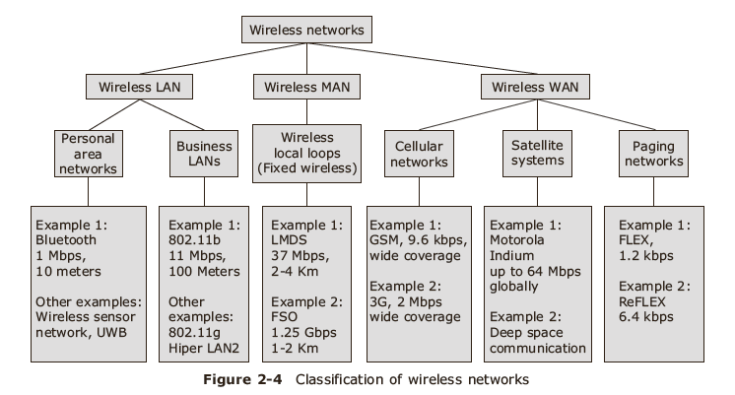
Classification of WLAN

Slide 10
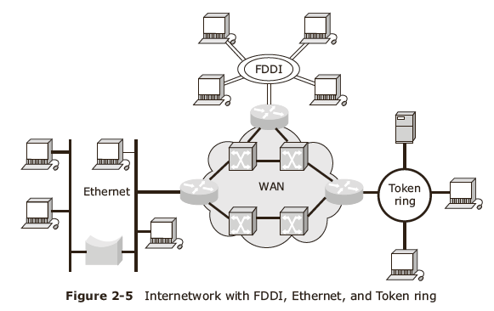
Internetworks

Slide 11
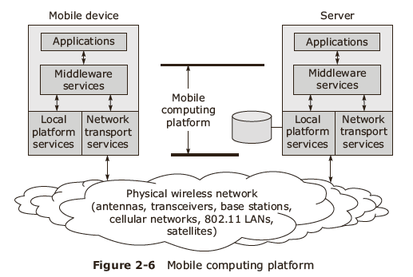
Wireless application protocols- WAP

Slide 12
Protocols for Network Systems

Slide 13
Protocols for network systems
Protocol is a formal set of rules and conventions that governs how computers exchange information over the network medium.
Protocol supports transparency
Protocols for networks
  ISO/OSI
  IP

Slide 14
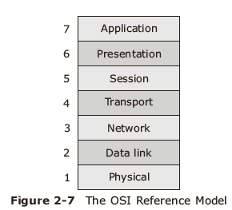
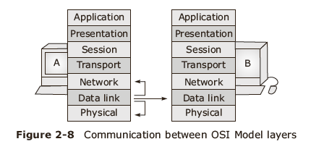
ISO/OSI Reference Model

Slide 15
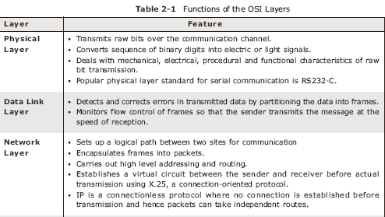
Functions of OSI layers

Slide 16
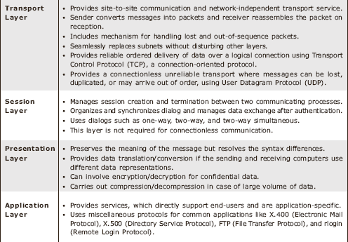
Functions of OSI Layers

Slide 17
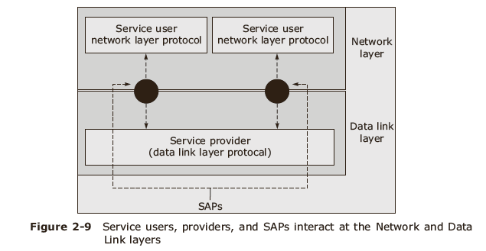
Elements in layered service:
  Service user
  Service provider
  Service Access Point (SAP)

Slide 18
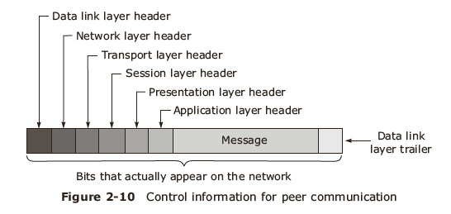
Control information in OSI layers

Slide 19
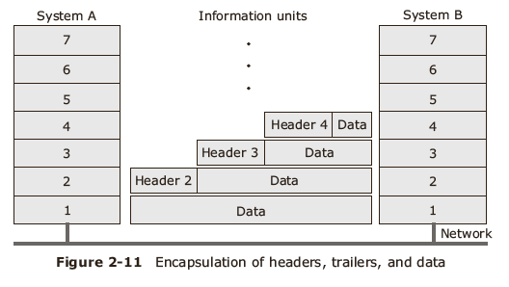
Data encapsulation in OSI protocol data

Slide 20
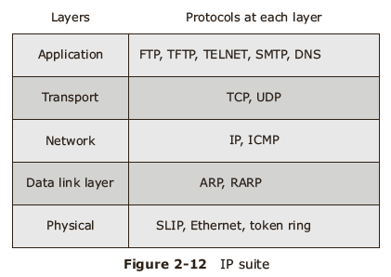
Internet Protocol

Slide 21
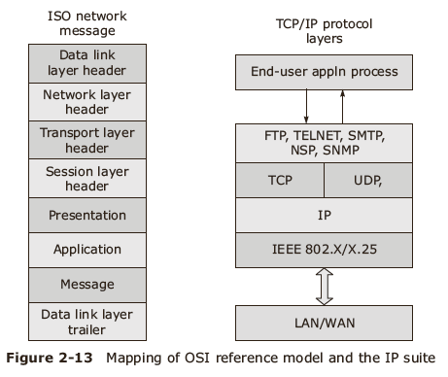
OSI vs IP

Slide 22
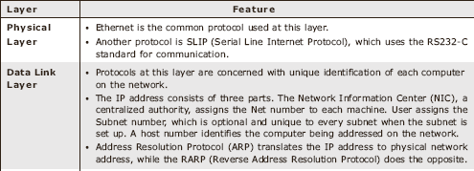
Major functions of the IP protocol

Slide 23
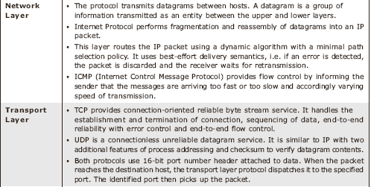
Major functions of the IP protocol

Slide 24
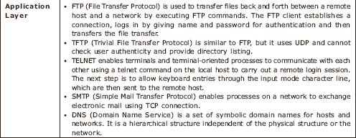
Major functions of the IP protocol

Slide 25
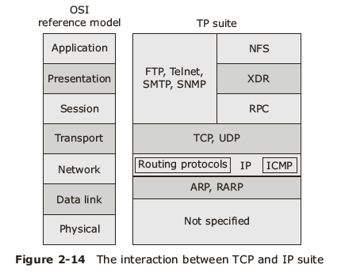
TCP and IP layers at a glance

Slide 26
Asynchronous Transfer Mode

Slide 27
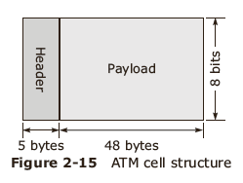
Introduction to ATM
Uses fixed length packets called cells,
Achieves fast speed by avoiding flow control and error checking.

Slide 28
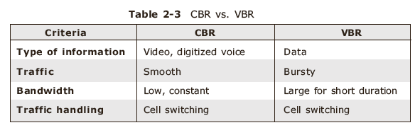
ATM classification
ATM can be classified as CBR and VBR based on the type and volume of data transmitted.

Slide 29
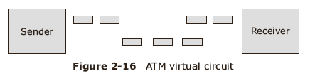
ATM virtual circuit

Slide 30
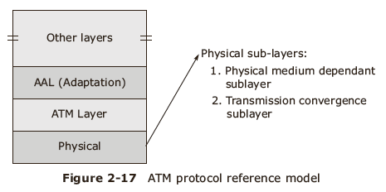
ATM Reference Model

Slide 31
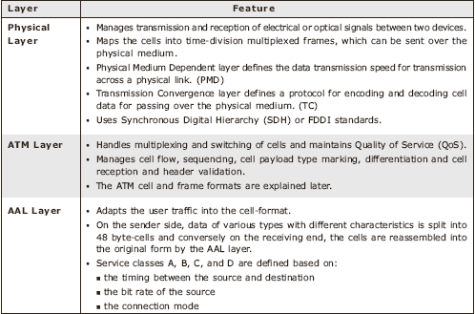
ATM Layer functions

Slide 32
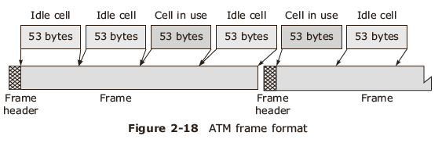
ATM Standards
Standard A:
  The User-Network Interface (UNI) standard contains the Generic Flow Control field (GFC) and Virtual Path Identifier (VPI) one-octet field.
Standard B:
  The Network-Network Interface (NNI) has one and a half octets long VPI but does not contain the GFC field.

Slide 33
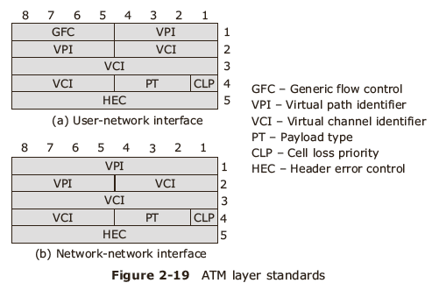
ATM layer standards

Slide 34
Functions of the ATM Layer field headers
Header Bit | Function
GFC | 4 bits in the cell header Controls the amount of traffic entering the network All 0 s indicate uncontrolled cell so gets last precedence
VPI and VCI | VPI contains 8 bits and VCI contains 16 bit field in header Determines the path and channels for the cell to traverse
PTI | 3 bits in header Distinguishes between data and control cells, which can be transmitted on different channels
CLP | 1 bit in header When set, indicates that the cell can be discarded during congestion
HEC | 8 bits in the header Contains the checksum of the header to protect from transmission errors

Slide 35
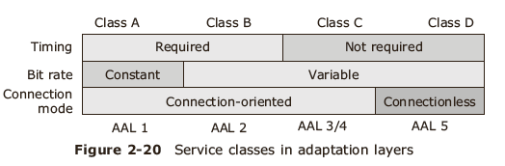
ATM Adaptation Layers

Slide 36
ATM Layer functions
Layer/Sublayer | Function
ATM adaptation layer Convergence sublayer Segmentation and reassembly sublayer | Convergence Segmentation and reassembly
ATM layer | Generic flow control Cell header generation/extraction Cell VPI/VCI translation Cell multiplex and demultiplex
Physical layer Transmission convergence sublayer Physical medium sublayer | Cell rate decoupling HBC header generation/check Cell delineation Bit timing Physical medium

Slide 37
Protocols for Distributed Systems

Slide 38
Protocols for Distributed Systems
VMTP-
  Versatile Message Transfer Protocol
FLIP—
  Fast local Internet Protocol

Slide 39
Requirements of Distributed Systems
Transparency
Client server based communication
Group communication
Security
Network management
Scalability

Slide 40
VMTP- Versatile Message Transfer Protocol
Supports request response behavior
Provides transparency and group communication facility, selective retransmission mechanism, rate based control flow control
Supports execution of non idempotent operations and conditional delivery of real time communication.

Slide 41
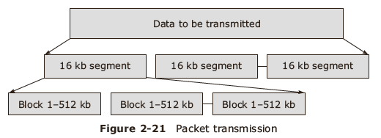
VMTP packet format

Slide 42
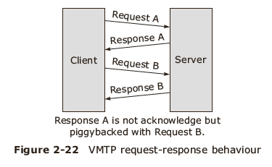
VMTP client server interaction

Slide 43
FLIP--Fast local Internet Protocol
Connectionless protocol
Provides
  Transparency for process migration
  Secure message delivery
  Group management- private and public addresses
  Network management
  Efficient client server based communication

Slide 44
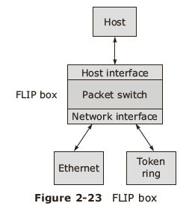
FLIP box interface

Slide 45
Summary
LAN and WAN technologies
Protocols for Network Systems
Asynchronous Transfer Mode
Protocols for Distributed Systems
  VMTP
  FLIP

